Slide 1
MAXIMIZING VISIBILITY AND IMPACT OF OPEN ACCESS AND OTHER WORKS:
Using Publisher APIs for IR Access to Articles by University Authors
Robert Vernon Phillips, University of Florida
Letitia Mukherjee, Elsevier
Brisbane, Australia ~ June 28, 2017
1
Notes:
I’m Robert Vernon Phillips, UF Smathers Library IT Analyst and Developer.

Slide 2

The Smathers Libraries are engaged in two projects that demonstrate collaboration between academic libraries and publishers for interoperability between information systems that benefit both.
Elsevier Pilot Project
CHORUS Pilot Project
2
Notes:
The University of Florida is increasing access to works of UF Authors, including Open Access works, via two related pilot projects, one with Elsevier and the other with Chorus.
The projects also that demonstrate one way academic libraries and publishers can work together for interoperability between information systems in ways that can generate benefits for both.
Before beginning these projects, our Dean Judy Russell had discussions over several years with her Provost, Vice President for Research, and members of the faculty, including the Faculty Research Council, about the need to document and provide improved access to faculty research -- without placing additional burdens on our already very busy faculty.
With the development of the White House Office of Science and Technology Policy (OSTP) mandates for deposit of the results of federally-funded research, these discussions began to include the word COMPLIANCE!
All of these discussions eventually ended with the plea — ”Why can’t the library solve this problem -- without placing additional burdens on our already very busy faculty.”
UF authors publish approximately 8,000 scholarly journal articles a year. Unfortunately, our faculty do not have a culture of deposit of their article manuscripts in the Institutional Repository (IR@UF), although many do rely on it for deposit of other content.
Obviously, it would be very expensive and time consuming for library staff to track down all of those manuscripts – and responding to our demands for those manuscripts would definitely place additional burdens on our already very busy faculty.

Slide 3
Why Elsevier? Why CHORUS?
University of Florida Articles by Publisher 2014
✔
Pilot participant and CHORUS member publisher
CHORUS member publisher (as of January 2016)
✔
✔
✔
✔
✔
✔
✔
✔
✔
3
Bubble size represents number of UF-authored articles published in 2014
Source: SciVal and Scopus
Notes:
Dean Russell is most frequently asked “Why Elsevier? Why Chorus?”, and this slide answers that question.
UF authors publish approximately 8,000 articles per year. 8 of the 10 publishers most selected by UF authors are CHORUS members.
Elsevier has the largest volume of any publisher, with 1,100 to 1,300 articles per year, followed by Springer/Nature and Wiley.
Automated solutions for identification and access to articles by UF authors from multiple publishers reduces the burden on our academic faculty, the library faculty and staff, and by sharing data on compliance, on the staff of the office of compliance of the VP research.

Slide 4
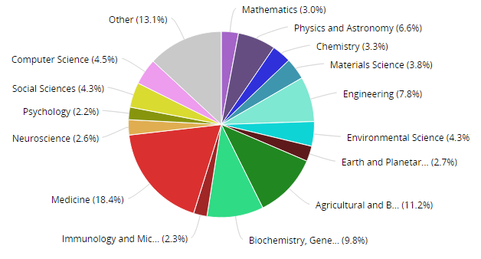
Why the University of Florida?
University of Florida Articles by Discipline 2014
4
Notes:
The inverse of that question is why would Elsevier and CHORUS choose to work with UF.
First, because Dean Russel asked! It helps to have a willing partner. Second, because UF is a large, comprehensive research intensive university. UF ranks 6th in the US in the production of PhDs, with 796 awarded last year.

Slide 5
UF/Elsevier Project - Phase I: Implement the Elsevier API Infrastructure to Deliver Enhanced Repository Services
Provide all UFDC visitors access to full-text of the UF-authored Open Access Elsevier articles.
Increase comprehensiveness of coverage of Elsevier-published content by UF authors through the IR@UF.
Provide subscribers with access to the best available (published) version through the IR@UF.
Allow users to return to their IR search results when reading final articles from ScienceDirect.
4
Notes:
Dean Russell approached Elsevier to request access to manuscripts by UF authors. Elsevier had the final submitted copy. Elsevier knew what rights our authors had retained or signed away.
When we began to explore that option, we learned that Elsevier had developed and wanted to test APIs to provide access to the published version through university institutional repositories. The implementers on the Libraries staff quickly decided to use the APIs, rather than to continue to seek the manuscripts.
There is not a culture of deposit at UF. We had only 7 Elsevier articles on deposit in the IR when the projected started. They were all supported by the UF Open Access Publishing Fund which required deposit of the final article in the IR.

Slide 6
UF/Elsevier Project - Goals and Discoveries
Phase I Goals:
Metadata and links for ~31,000 articles by UF authors in IR@UF from 1949 - 2016
Indexing based on metadata
Links to ScienceDirect for access by licensed users
Phase I Discoveries:
More gold OA publishing than anticipated (601 articles by 1,443 unique UF authors between 2009 and early 2016)
Phase II Goals:
Streaming final articles or accepted manuscripts to IR@UF
Indexing based on metadata and full-text
Learning from usability testing
5
Notes:
The most difficult problem was identifying UF authors. The words University and Florida appear in the names of a number of institutions! We have long supported ORCID IDs, but we now also strongly support institutional identifiers.
The most surprising discovery was the high number of open access articles published by UF authors in Elsevier journals. We are doing further analysis of open access publishing by these authors and expect to survey them to learn more about their motivation and source of funds. We hope some of them will become champions for a campus-wide open access policy.
8 to 10 of these authors published over 20 OA articles with Elsevier in these 7 years; one published 30.

Slide 7
Elsevier APIs for Institutional Repositories
IR@UF retrieves article metadata
Confirms eligibility for full-text on ScienceDirect
Article access status indicated on results page
Eligible user linked to full-text ‘best (published) version’
Central collection of impact metrics on ScienceDirect
Content Identification API
User Verification API
Article Retrieval API
7
Adapted from Spears, IFLA 2016
Notes:
Multiple free APIs that work together to provide access

Slide 8
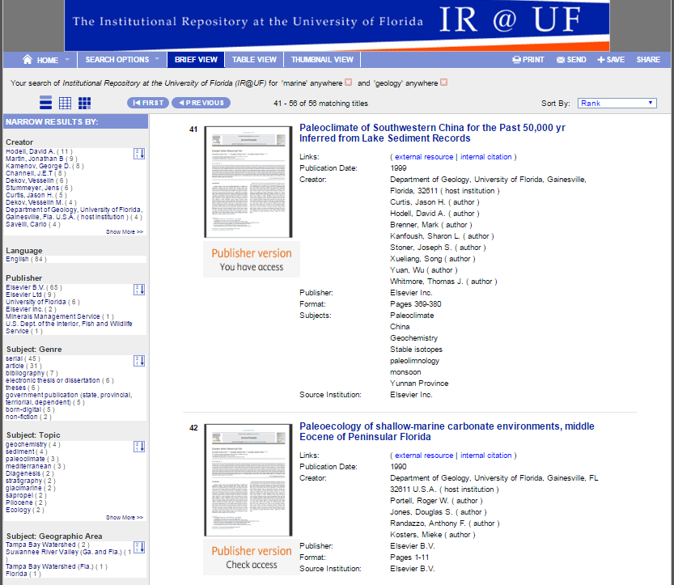
View of Results with Elsevier Articles from IR@UF
8
Notes:
This is a screen capture of a couple of these Elsevier articles as they appear in the IR@UF.
The item with Check Access circled was published in 1990. UF does not own the backfile for that journal.
Consequently the Elsevier API identifies (correctly) that a user accessing the article from the UF IP range may not be entitled to access.
A user from another institution with access to the backfile would see the message You have access.
The API presents results that are specific to the status of the individual user.

Slide 9
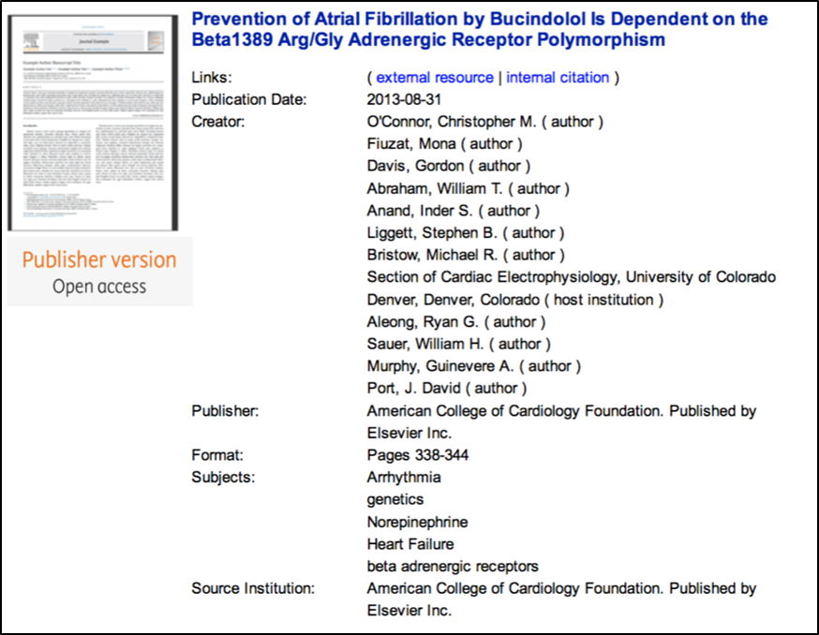
View of Results with Elsevier Articles from IR@UF
9
Notes:
UF wanted to highlight open access articles – not just to say you have access, but to identify the articles as open access articles.
We are currently working with Elsevier on the tagging and displaying manuscripts that are available to users without subscriptions.

Slide 10
UF/Elsevier, Phase II: Refine the API Infrastructure and
Expand Enhanced Repository Services
Provide an access option for users without a subscription: viewing of the post-embargo accepted manuscripts (2013 forward).
Offer full text searching through the IR@UF, with links to the published article on ScienceDirect.
Usability testing by Elsevier and UF.
Research on open access publishing by UF authors and use of Elsevier metadata for other University purposes, including compliance.
10
Notes:
Phase I was completed several months ago, and we are now well along in Phase II.
PAUSE HERE FOR Elsevier presenter (Letitia had family emergency, may be Macy Lee)
– then RESUME WITH BRIEF DISCUSSION OF CHORUS PROJECT

Slide 11









Publisher led initiative
Low cost solution that widens access, compliance, discovery, and preservation of peer reviewed articles
Addresses critical pain points of cost and efficiency by:
Avoiding duplication of effort
Increasing compliance
Maximizing the benefit from existing, proven infrastructure
Transparent reporting and tracking for funders and institutions
Currently operational for US federal agencies and piloting services in Japan
Piloting services for Institutional Repositories and Research Data

Slide 12















































PLUS OVER 118 SIGNATORIES
Notes:
Here is a look at the variety of publishers and scholarly societies that make up our membership. There are 50 members and we are tracking well over 3000 journals.
The majority of our members are not for profits like the Royal Society, AAAS, NAS, the Optical Society as well as commercial houses like Hindawi, Springer Nature, Elsevier and Wiley.
OA and subscription publishers alike are part of CHORUS as well as the system vendors who support their efforts.

Slide 13

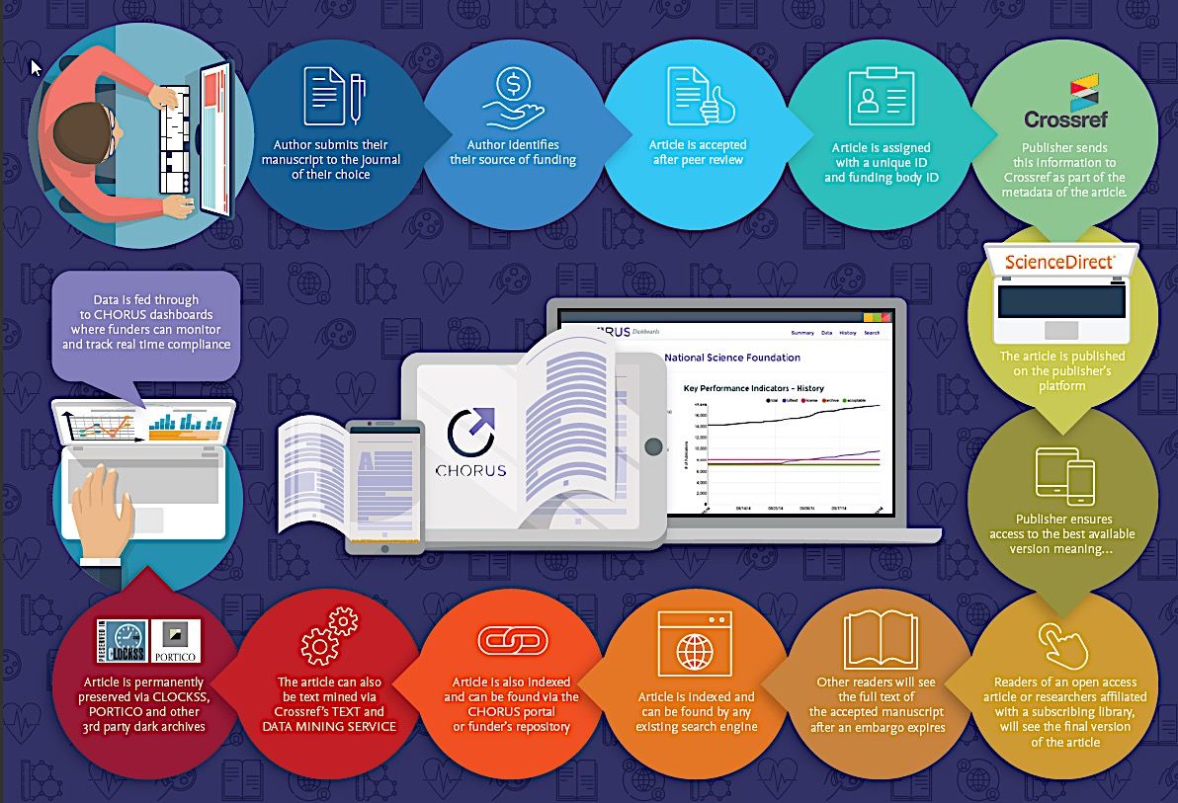
How CHORUS Works

Slide 14







Publisher
Identification
Discovery
Agency
COMPLIANCE
Public
Preservation
Access
Librarian
Office of
Research
Researcher
Adapted from a Slide by Howard Ratnor, SSP 2014
14
Notes:
When I first saw this slide, the word compliance was, as it is now, in the center, but there was one less figure on the slide. I went up to Howard Ratnor after his presentation about CHORUS and told him that the person on my campus who was loosing sleep over compliance wasn’t on his slide: the Vice President of Research. I acknowledged the need to focus the initial development of CHORUS on publishers and funding agencies, but pointed out that this was a three legged stool and there were three figures from academic institutions (the librarian, the VP research and the researcher) who were not participating in the design of the CHORUS system. I suggested that when they were ready, UF and other academic institutions should participate in the development of CHORUS to ensure that it met our needs as well as those of publishers and funders. A few months ago, Howard contacted me and said they were ready to expand the partnership and asked if UF would participate. I quickly agreed. This offer came about in part because of the pilot project we had already begun with Elsevier, which CHORUS members had been observing closely.
We expect to issue a report on the initial phase of the CHORUS project in May – and add additional libraries and additional publishers to the next phase of the project.

Slide 15







Pilot Working Group - Publishers
15
Notes:
As I mentioned earlier, 8 of the 10 publishers most selected by UF authors are CHORUS members, which is one of the main reasons we are working with CHORUS in an additional joint project.
7 CHORUS members are already participating in this pilot and we expect more to join.

Slide 16
UF/CHORUS Pilot Project Strategies
Identification
Identify and collect metadata for articles written by institution staff, faculty and students & published by CHORUS pilot member publishers (Scopus / CHORUS)
Filter and sort by US agency funding (CHORUS)
Compliance
Develop institutional dashboards, alerting and reporting (CHORUS)
Collaborate to create mechanisms to track and report on compliance (CHORUS / Institution)
13
Notes:
The most important goal is facilitating compliance. The major steps are to identify articles by UF authors; check the metadata for the funding source; verify deposit in the appropriate funder repository; and report to UF.
The report might indicate that Professor Smith published an article based on a DOE grant and it is in the DOE mandated repository, while Professor Jones published an article funded by NSF that is not yet in the mandated repository. A subsequent report might confirm that Professor Jones’ article is now in the repository.
The office of compliance would only need to follow up on articles that were not yet deposited.

Slide 17
UF/CHORUS Pilot Project Strategies
Engagement
Generate interest and involvement of other stakeholders in the project (e.g., funders, other institutions and CHORUS publishers, preservation services)
Recommendations to minimize duplication of effort and burdens on researchers
Explore related metadata, identifier and compliance initiatives and map future interactions
14

